Slide 1
Lecture no : 09 k mean clustering

Slide 2
What is K-means clustering
What is K-means clustering?
K-means clustering is like grouping similar items together in a store. Imagine you're organizing a grocery store, and you want to group similar fruits together to make shopping easier. K-means does the same thing but with data points.

Slide 3
How does it work?
First, you choose the number of groups you want (K). Then, K-means algorithm starts by randomly placing K centroids (imaginary points) in your data space. It then iteratively assigns each data point to the nearest centroid and recalculates the centroids based on the mean of all points assigned to it. This process repeats until the centroids stop moving significantly.

Slide 4
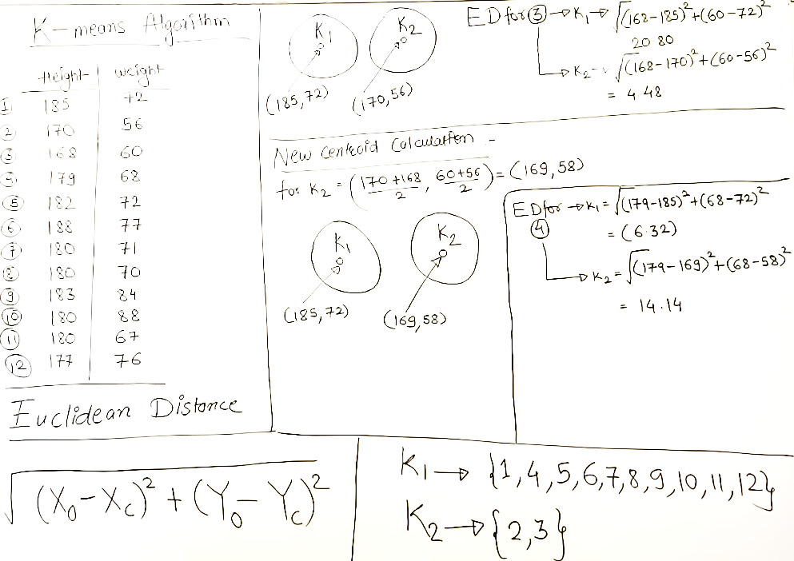
K mean clustering:

Slide 5
Real-world applications:
Market Segmentation: Identifying different customer segments based on their purchasing behavior.
Image Compression: Reducing the size of an image by grouping similar pixels together.
Anomaly Detection: Finding unusual patterns in data, like fraud detection in financial transactions.

Slide 6
Advantages:
Simple and easy to implement.
Efficient for large datasets.
Works well with data that is well-separated into clusters.

Slide 7
Disadvantages:
Requires the number of clusters (K) to be specified in advance.
Sensitive to initial centroid placement, which can lead to different results with each run.
May struggle with clusters of varying sizes and densities.

Slide 8
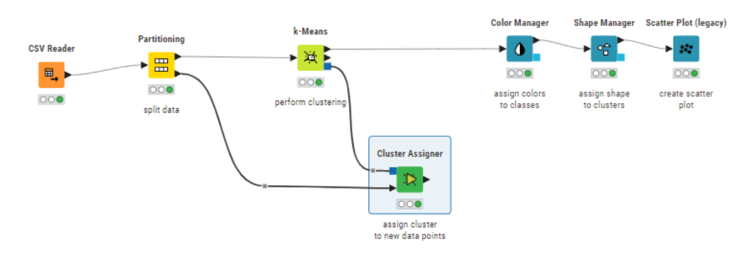
K mean clustering in knime:

Slide 9
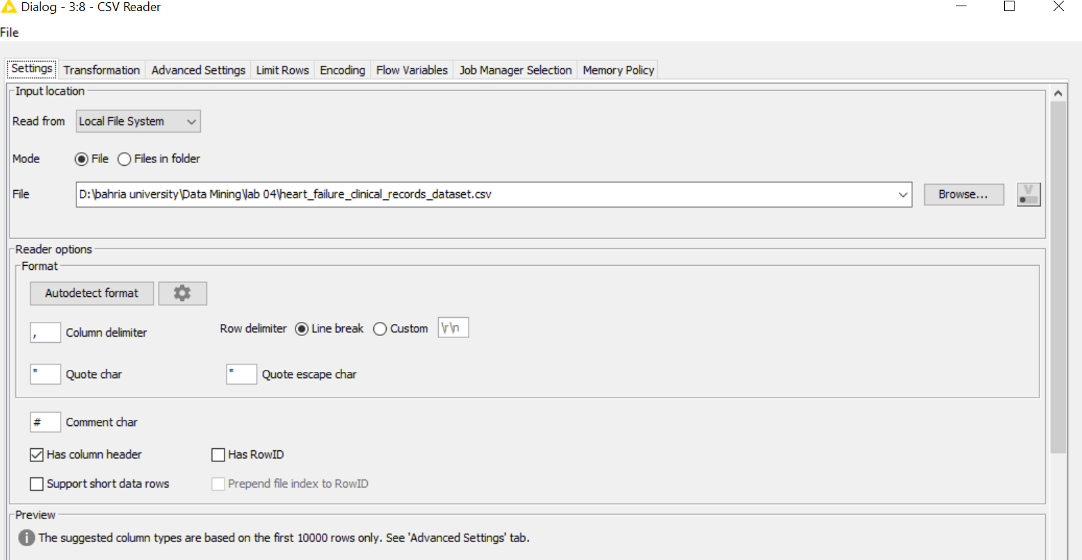
Csv reader:

Slide 10
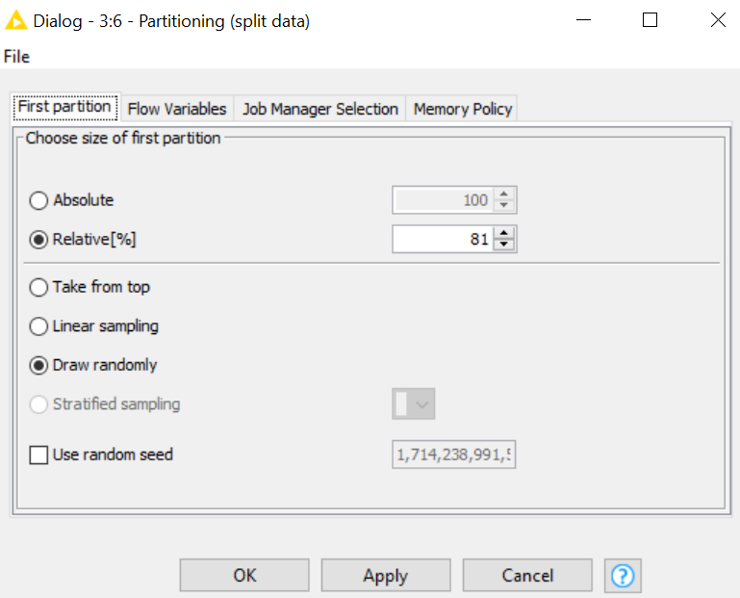
Partitioning:

Slide 11
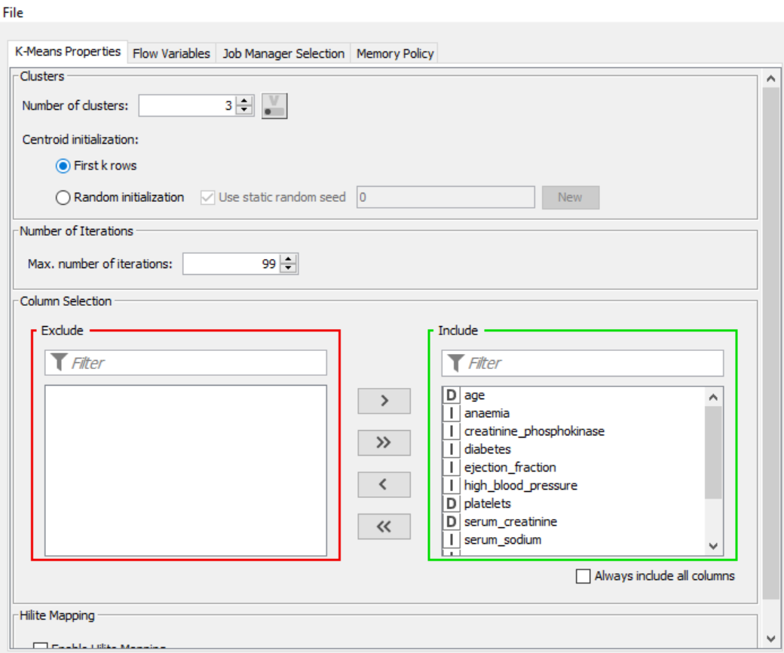
K mean:

Slide 12
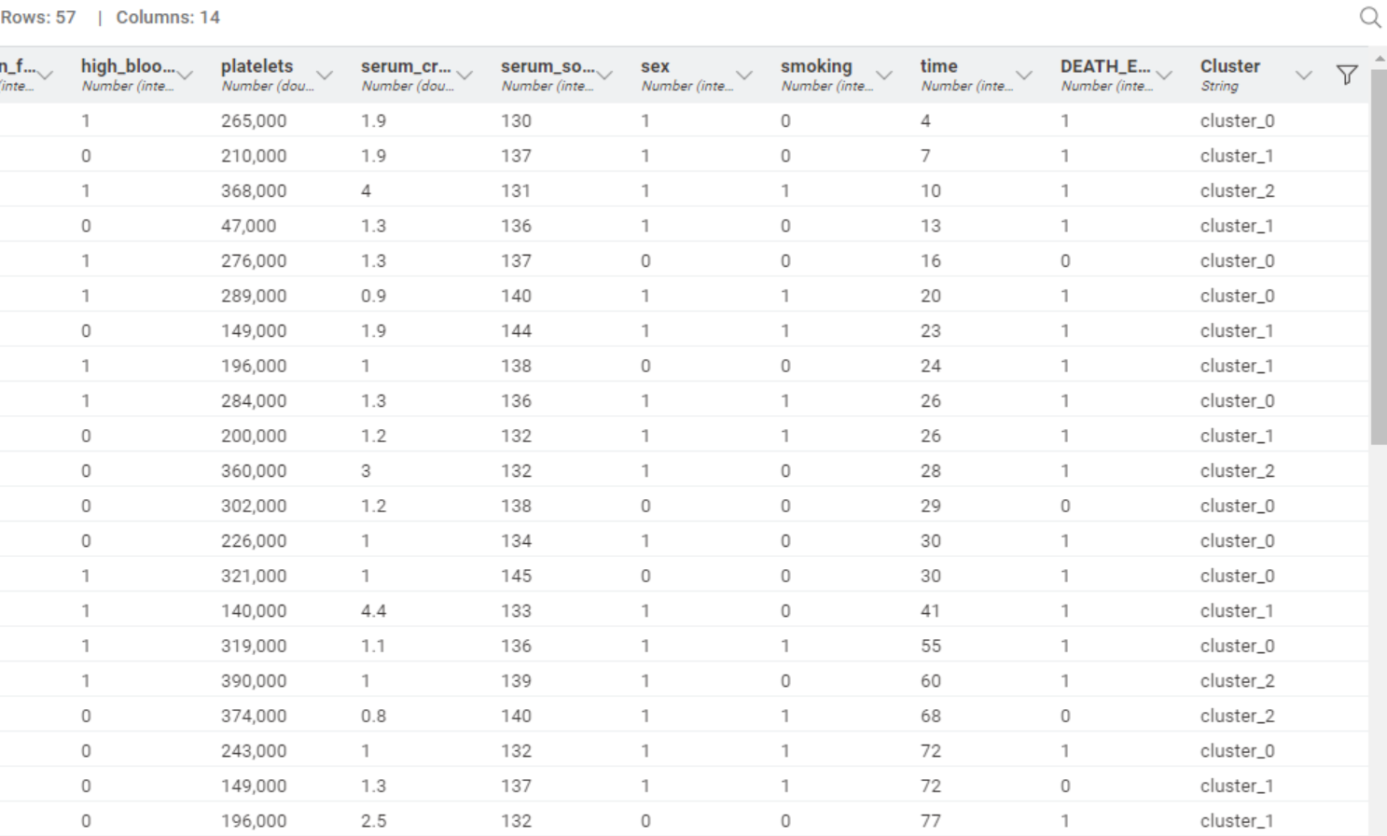
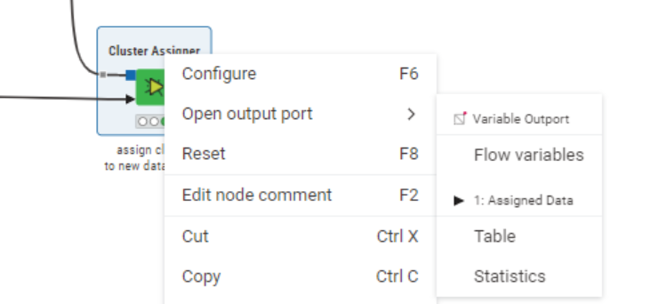


Cluster Assigner (assigned data table)

Slide 13
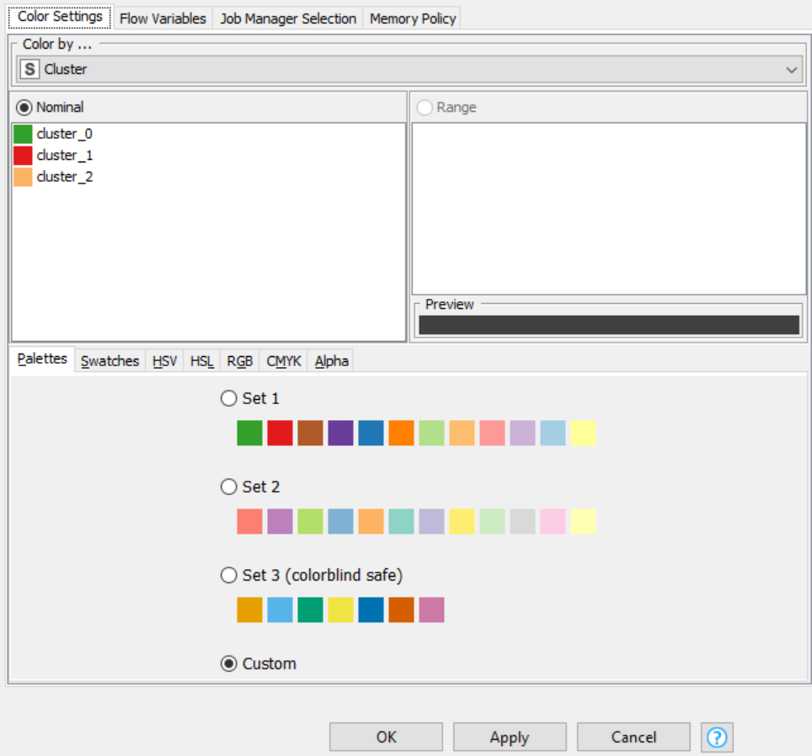
Color manager:

Slide 14
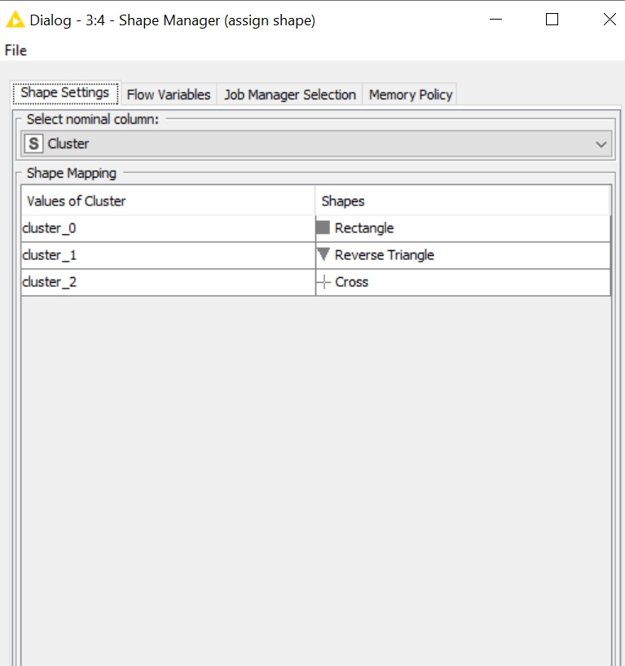
Shape manager:

Slide 15
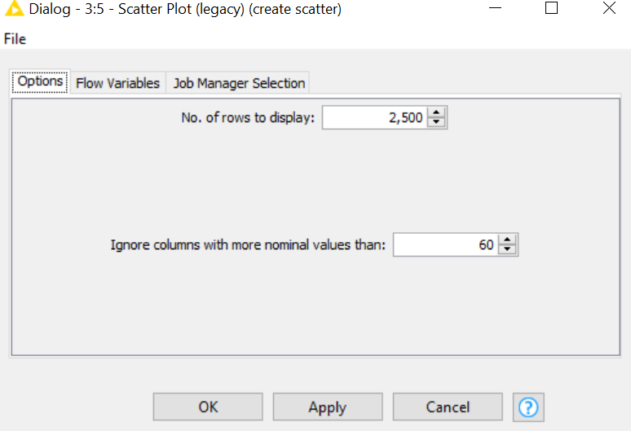
Scatter plot:

Slide 16
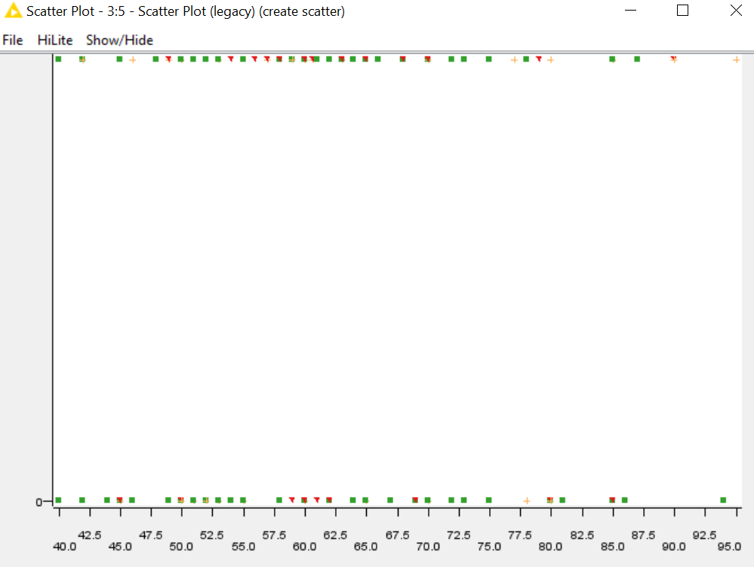
Scatter plot output:

Slide 17
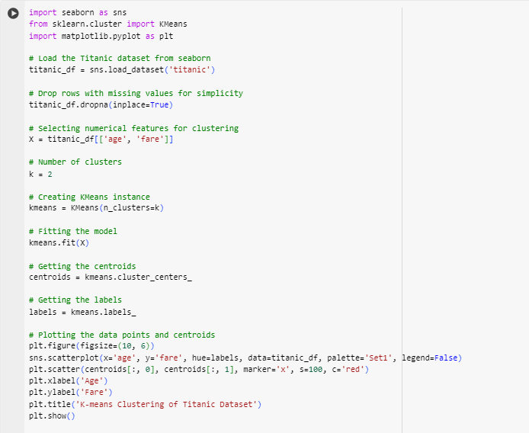
K-mean clustering in python

Slide 18
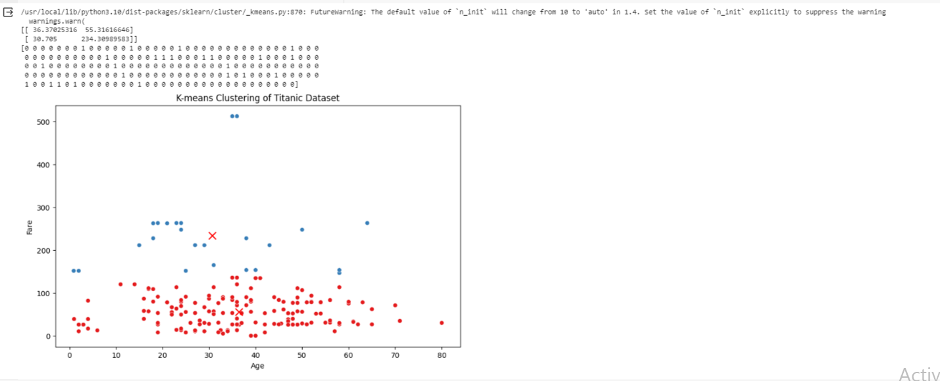
Visualization:

Slide 19
Task: Lab Tasks/Practical Work
You work as a data scientist at a botanic garden, and your team is interested in analyzing the Iris dataset to identify patterns in the measurements of different types of iris flowers. The dataset contains measurements for the sepal length, sepal width, petal length, and petal width of three different types of iris flowers: Setosa, versicolor, and virginica. Your goal is to use K-means clustering to group the flowers based on their measurements and determine if the measurements can be used to accurately identify the different types of iris flowers.
Perform K-Mean Clustering in KNIME on IRIS dataset

Slide 20
Tasks: Lab Tasks/Practical Work
You work as a data scientist at a botanic garden, and your team is interested in analyzing the Iris dataset to identify patterns in the measurements of different types of iris flowers. The dataset contains measurements for the sepal length, sepal width, petal length, and petal width of three different types of iris flowers: setosa, versicolor, and virginica. Your goal is to use K-means clustering to group the flowers based on their measurements and determine if the measurements can be used to accurately identify the different types of iris flowers.
1. Load the Iris dataset into a Pandas dataframe.
2. Drop the 'species' column from the dataframe, as we will be performing unsupervised clustering.
3. Scale the data and use the elbow method to determine the optimal number of clusters for K-means clustering.
4. Perform K-means clustering on the scaled data using the optimal number of clusters.
5. Visualize the results of the clustering by creating a scatter plot of the data points, with each point colored based on its assigned cluster.
6. Analyze the results of the clustering to identify patterns in the measurements of the different types of iris flowers.

